Slide 1
ADC_03 Introduction to ICT & Entrepreneurship: Digital Disruption

Slide 2
42 Abu Dhabi
Topics:
Digital Disruption
Digital Transformation
Digital Technologies
API
AI & ML
Blockchain
5G
Cloud Computing
IoT
Big Data Analytic
Technology Adoption Barriers

Slide 3
42 Abu Dhabi
Notes:
Every industry – whether it’s oil and gas, retail, financial services, agri-tech – all are being transformed by digital technology.⸺ Satya Nadella, Microsoft CEO.

Slide 4
42 Abu Dhabi
Pre-Class Activity:
Get familiar with the following concepts: Digitalization, Digitization, Disruptive Technology, and Digital Transformation.
To what extend you do believe that using Digitalization/technologies will help businesses in their growth. Support your opinion with examples.
Think about your industry (Or an industry of your interest) and how technologies has transformed it.
What new trends currently are emerging?
What challenges or opportunities do current trends present?
Notes:
https://www.arcweb.com/blog/what-digitization-digitalization-digital-transformation

Slide 5
42 Abu Dhabi
Digital Disruption :
Digital Disruption is an effect that changes the fundamental expectations and behaviors in a culture, market, industry or process that is caused by, or expressed through, digital capabilities, channels or assets.
Digital Disruption is a transformation that is caused by emerging digital technologies and business models. These innovative new technologies and models can impact the value of existing products and services offered in the industry.
This is why the term ‘disruption’ is used, as the emergence of these new digital products/services/businesses disrupts the current market and causes the need for re-evaluation.
Disruptive technology is an innovation that significantly alters the way that consumers, industries, or businesses operate.
If you do not make life easier for your customers, someone else will.
Give to people something they really want.
Around “40% of businesses, unfortunately, will not exist in a meaningful way in 10 years. 70% of companies will attempt to go digital but only 30% of those will succeed.

Slide 6
42 Abu Dhabi
Digital Disruption :
An Example of Digital Disruption: Kodak Cameras Fail To Capture Future Markets
Kodak were one of the first to introduce cameras to the mainstream market. They monopolized the markets for the majority of the 20th century, but unfortunately failed to keep up with the changing identities of their customers and the changing needs and expectations that came along with them.
Digital cameras made the move from being a just piece of photographic equipment to being a much more life-friendly, fun gadget. Some clever marketing from other digital technology brands led to changes in consumer perceptions and created a new ‘need’ for photographic gadgets.
This allowed brands such as Sony and Canon to swoop in and steal the hearts of the consumers with their new technologies and approaches, while Kodak stuck to their guns and fought the change for as long as they could. Despite rapidly losing market share, they refused to succumb to the inevitable force of digital disruption and in 2012 they eventually declared bankruptcy.

Slide 7
42 Abu Dhabi
Digital Transformation :
Digital transformation is the process of integrating digital technologies into business operations in order to radically alter how firms operate.
Finding new opportunities in an existing business to reinvent the way value is delivered to customers is what digital transformation is all about.

Slide 8
42 Abu Dhabi
How Fast is Technology Growing?
Technology grows by 2x every 18 months in processing capacity.
Over 89% of Big Data has been generated in the past two years.
A total of 5.03 billion people around the world use the internet today – equivalent to 63.1 percent of the world’s total population.
Number of Tech startups globally: As of Q4 2021, there is 1.47 million tech startups around the world. Fintech sits at the largest, making up roughly 7% of the total. This number differ geographically vastly based on several factors.
50% of today’s tech growth derives from disruptive tech such as AR/VR, Robotics, SaaS, AI, .. etc.

Slide 9
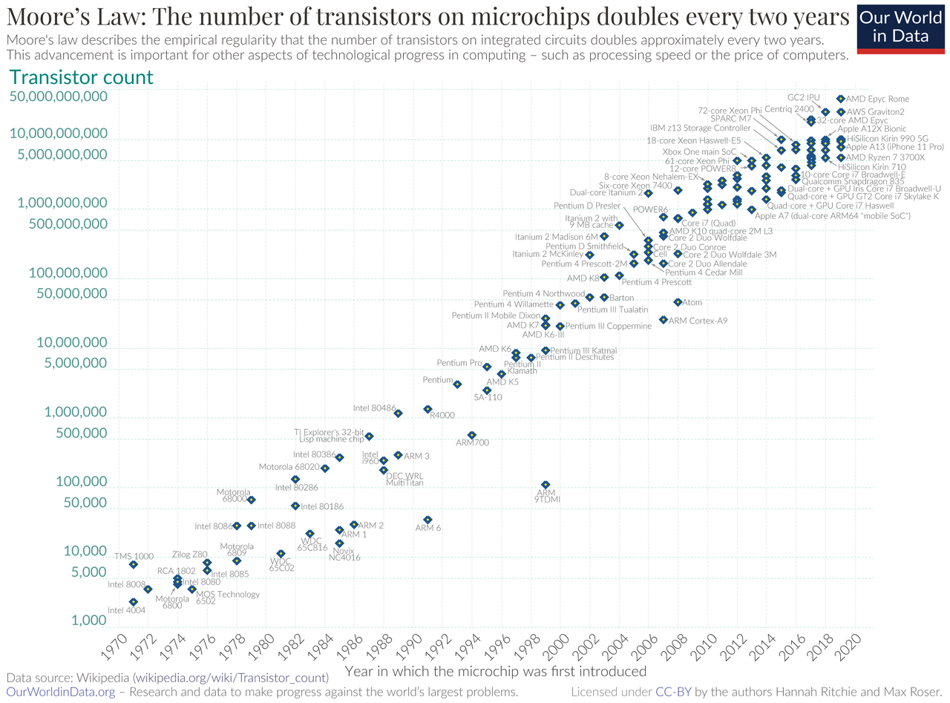
42 Abu Dhabi
How Fast is Technology Growing?

Slide 10
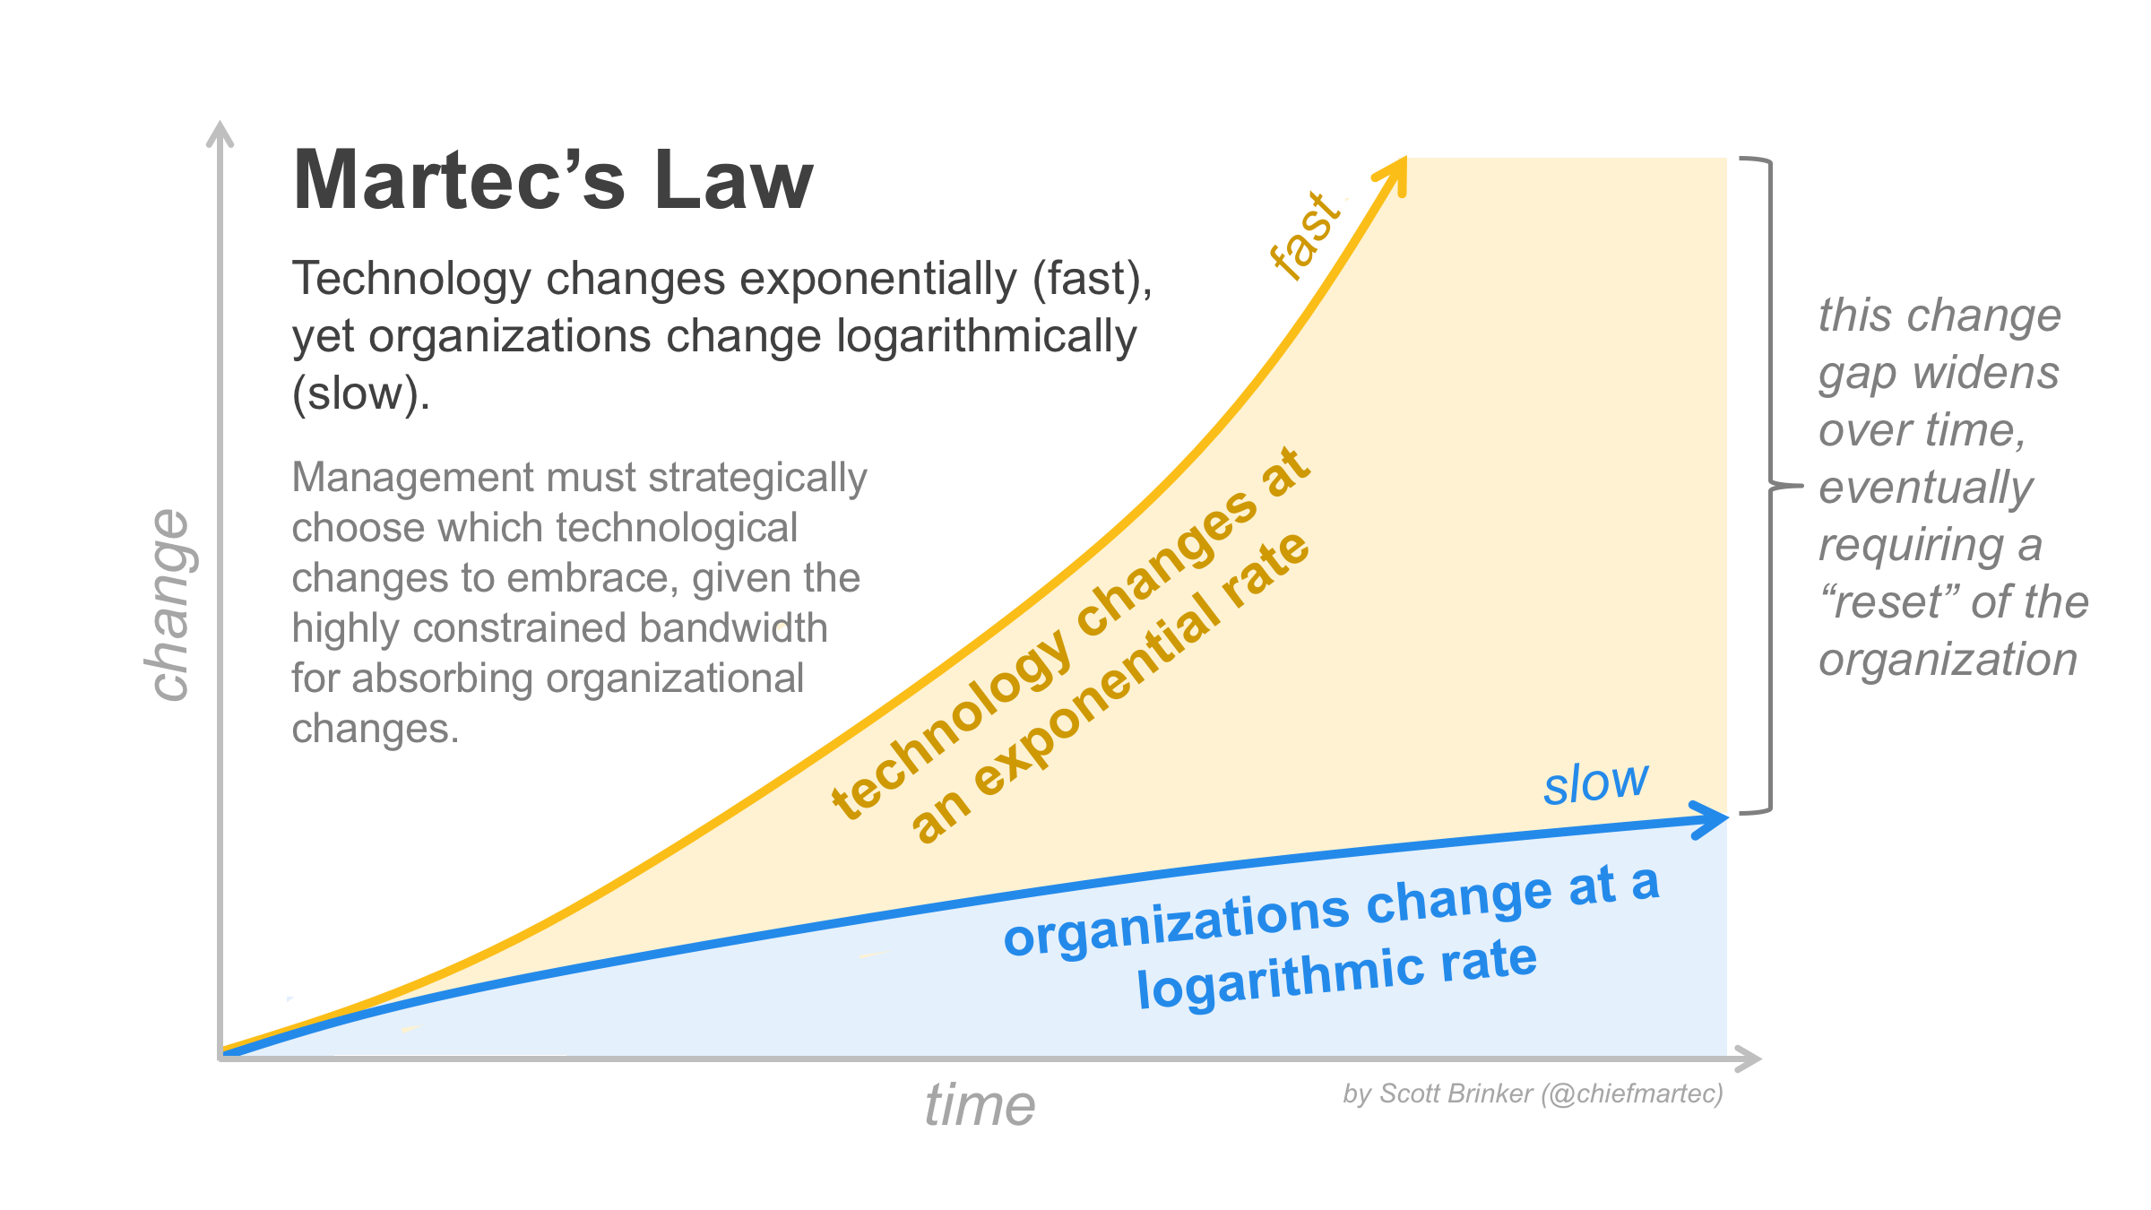
42 Abu Dhabi
How Fast is Technology Growing?

Slide 11
42 Abu Dhabi
How Fast is Technology Growing?
Moore’s Law: Technology changes at an exponential rate.
Martec’s Law: Technology changes exponentially, but organizations change logarithmically.
So, how do we manage relatively slow-changing organizations in a rapidly changing technological environment?

Slide 12
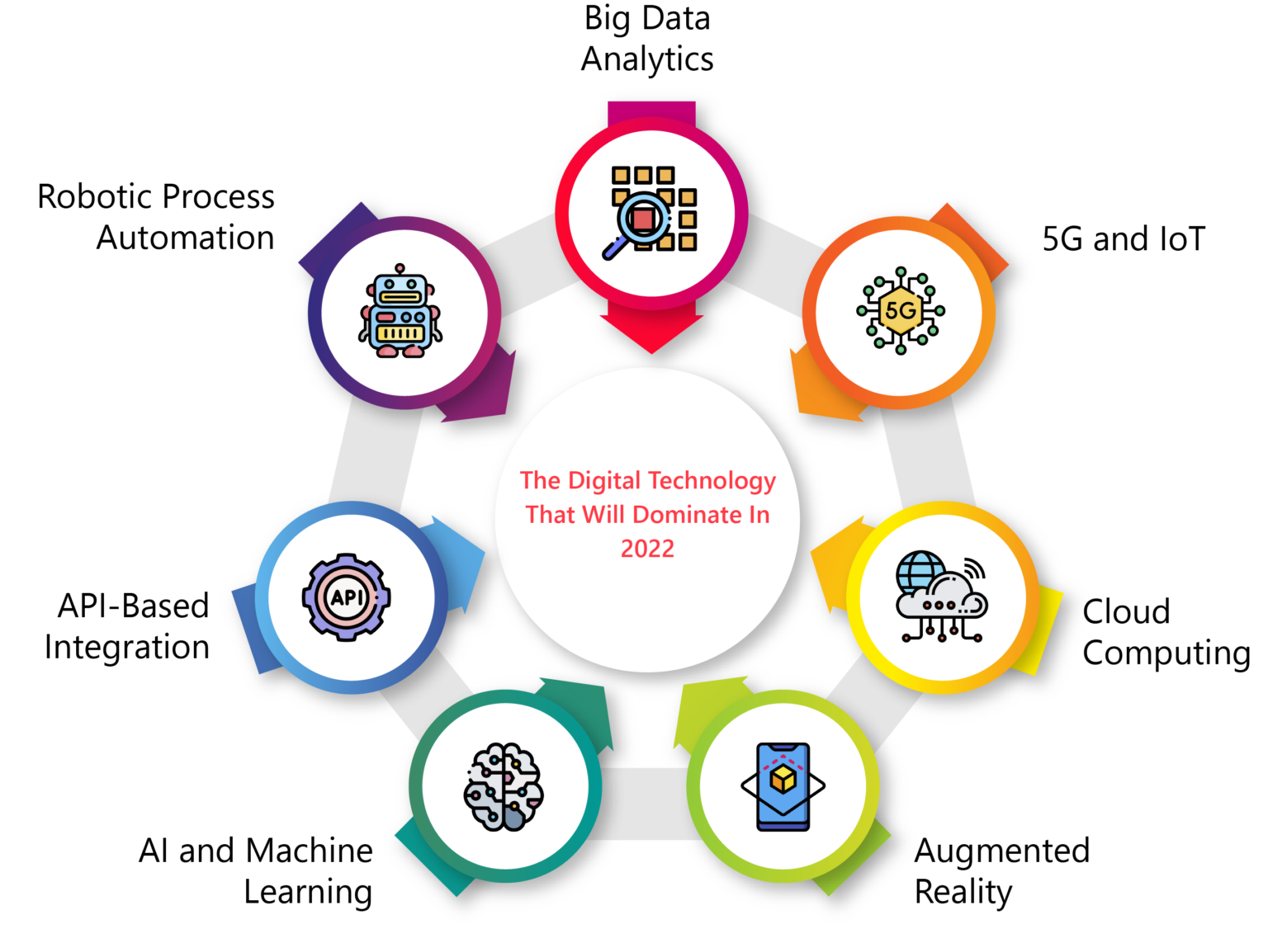
42 Abu Dhabi
Digital Transformation :

Slide 13
42 Abu Dhabi
API Economy:
Application Programming Interfaces (APIs)
API Economy (also known as API-driven economy) simply refers to the exchange of value between consumers and providers through APIs.
API Economy Examples
Take Uber, for example. This simple mobile app disrupted the entire transportation industry by combining public APIs with their proprietary processes. This ride-sharing company started by consuming the API of Google Maps without having to build its own mapping system.
Another example is McDonald’s partnering with Uber Eats to get food delivered to hungry customers without deploying its own delivery services.

Slide 14
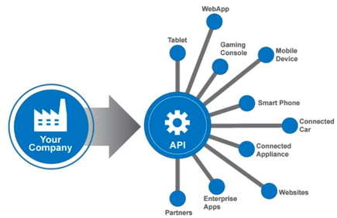
42 Abu Dhabi
API Economy:
The API Economy has enabled organizations to transform new ways to create value and extend their services.
Successful organizations that participate in the API Economy gain many benefits:
Improved customer experience
Continuous innovation
Increased efficiency: Participants in the API Economy focus on making their digital assets readily accessible. This makes it easier for all participants to develop unique products, services and functionality quickly and with less cost.
Fast delivery: having open, modern industry-accepted development tools means it’s faster to build and bring products to market and to realize new opportunities for revenue more quickly.

Slide 15


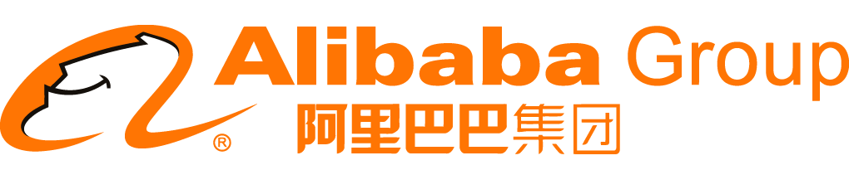

42 Abu Dhabi
API Economy:
Largest taxi company, owns zero taxis.
Largest media company, owns zero content.
Largest hotelier, owns zero real estate.
Most valuable retailer, owns zero inventory.
Largest travel agency brands, owns zero travel companies.

Slide 16
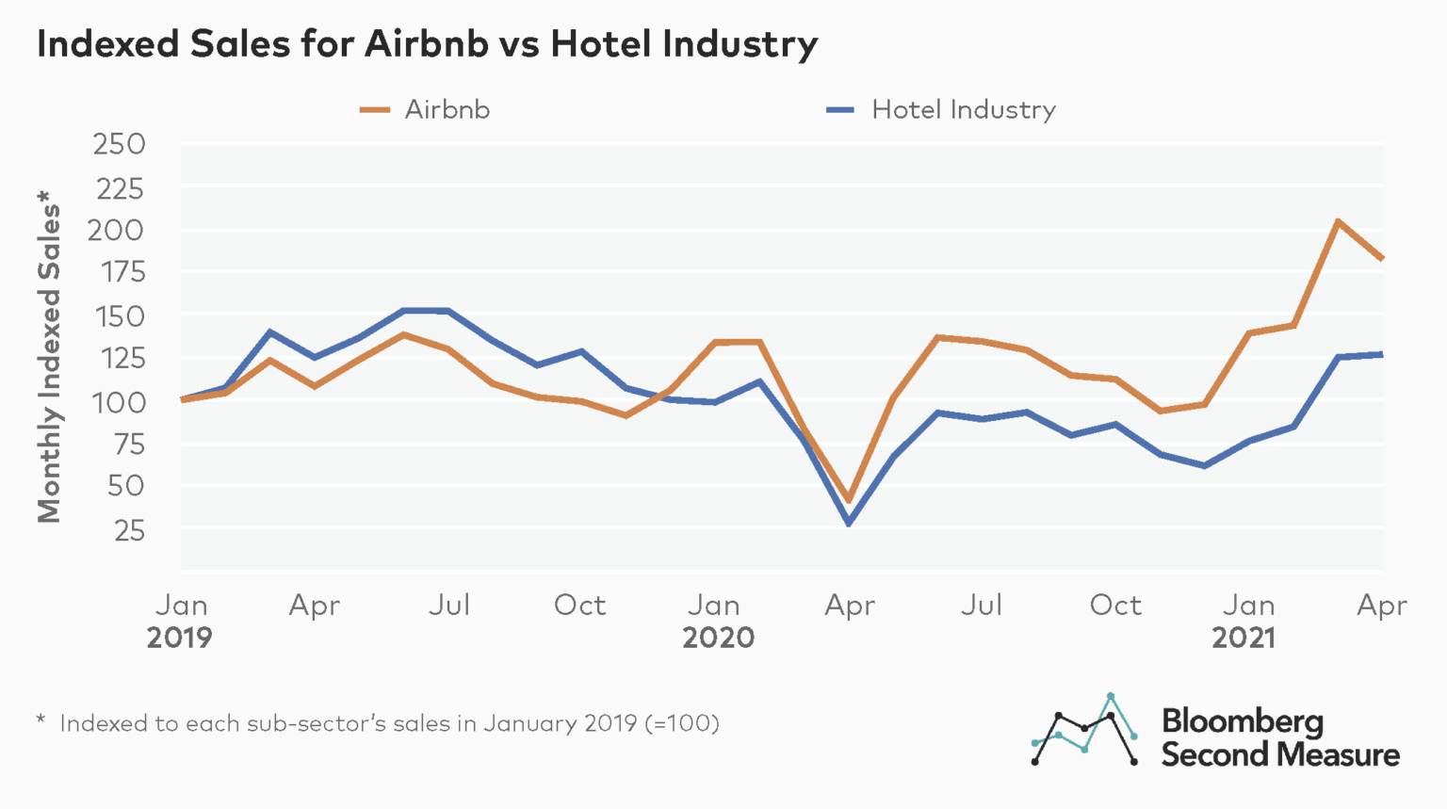
42 Abu Dhabi
API Economy:
Airbnb vs Hotel Industry
Is it because of price? Why Airbnb is cheaper usually?

Slide 17
42 Abu Dhabi
AI and Machine Learning:
Machines are beginning to build human-like capabilities.
AI is a system that is able to exhibit traits of human intelligence like reasoning, learning from experience or interacting with humans in natural language.
AI Ingredients:
Processing power - IBM Deep Blue
lots of available data,
and last but not least, set of techniques and algorithms
It should not be an explicit procedure.
For example, one that describes all the criteria to recognize a bird in a picture. Try to write such a list, you'll see how difficult it is. So, on the contrary, we need to write algorithms capable of looking at thousands of bird pictures and inferring from that some implicit way to recognize a bird.
It doesn't need to be explainable

Slide 18
42 Abu Dhabi
AI and Machine Learning:
Machine learning is a statistical technique in which computers can improve performance over time in the conduct of a particular task.
There are a variety of algorithms that can be used in the machine learning process. One such algorithm is the artificial neural network that is used to model complex relationships and find data patterns.
AI is a software program that simulates human thought.
AI is used in Google Translate and many of the personal assistants, such as the Apple Siri and Amazon Echo.
The Difference Between A.I. and Machine Learning and Deep Learning

Slide 19
42 Abu Dhabi
AI and Machine Learning:
Business Applications: estimate arrival time for millions of Uber rides based on city traffic history, predict your customer behavior, what else?
Companies should realize that the capability of an AI are vast and not all business possibilities have been explored yet.
This is why most if not all technology players are heavily invested in AI
AI Challenges: Bias, Unexplainable, Ethical and legal issue

Slide 20
42 Abu Dhabi
Blockchain:
How does a blockchain work
Blockchain is a technology that is mostly associated with cryptocurrencies, especially Bitcoin. But blockchain has many potential applications, which are just beginning to be explored.
Blockchain is merely a digital ledger that cannot be altered. It can improve the speed of transaction execution and validation across multiple parties.
Blockchain is an open, distributed ledger that can record transactions between two parties efficiently and in a verifiable and permanent way.

Slide 21








42 Abu Dhabi
Blockchain:
Problem: Difficult to monitor asset ownership and transfers
It is trust issue
Ledger
Ledger
Ledger
Ledger
Ledger
Ledger
Ledger
Ledger

Slide 22




42 Abu Dhabi
Blockchain:
Solution: Blockchain – synchronized, consensus, irreversible, provenance and efficiency.
Ledger
Ledger
Ledger
Ledger
Ledger
Ledger
Ledger
Ledger
Notes:
Blockchain platforms can add value by allowing participants in a value chain to use a shared repository for their records of operation
These shared ledgers are distributed among participants in a peer-to-peer network
Can eliminate siloed record keeping infrastructure at a large scale
Remove duplication, inconsistency and the need for reconciliation of records.
We can envisioning these shared ledgers forming an accountability layer in a network environment that enables collective trust among the network participants.
Blockchain can be described as a network of computers, each having an identical copy of the database (distributed). There is no need for any central server or agent to bring trust. Remember, the ledger is distributed, so everyone involved can see the “status” at any point in time and can monitor the progress of the transaction. Since all parties can view the distributed ledger, everyone can agree on how the transaction is progressing while it is ongoing, and how it went once it is complete.
The core characteristics of blockchain, immutability, speed and security, create the ideal platform for tracking and protecting high-value assets and critical data.
Records encrypted on the blockchain are immutable – permanent and cannot be changed. This provides a single version of the truth and provides assurance on the authenticity of the data.
The decentralised nature of blockchain provides security for the records. Information is also secured via cryptographic methods.
A combination of public and permissioned ledgers allows everybody to have viewing accessibility to the provenance of the diamond, but also controls the access to private and confidential information for permissioned users only.

Slide 23
42 Abu Dhabi
Blockchain:
Blockchain for Supply Chain Transparency & Traceability

Slide 24
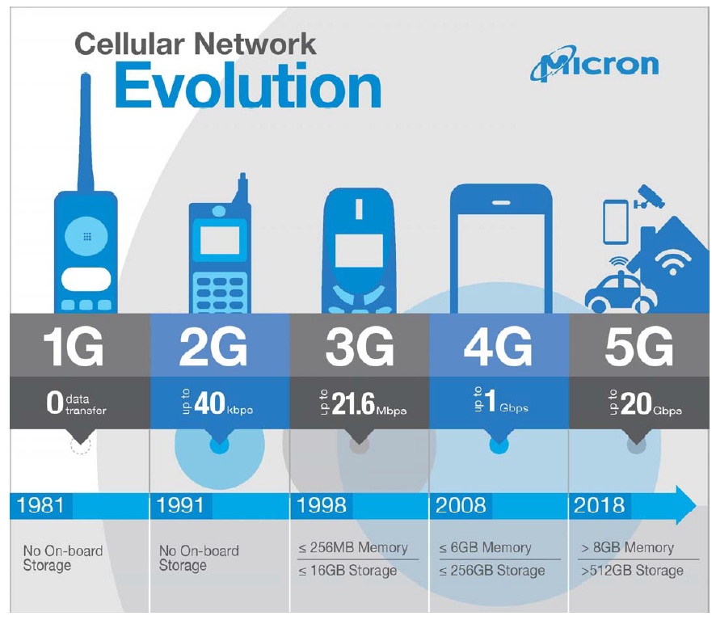
42 Abu Dhabi
What is 5G?
5G is next generation networking

Slide 25
42 Abu Dhabi
The Race to 5G:
Today’s mobile users want faster data speeds and more reliable service.
5G—promises to deliver that, and much more.
5G is still in the planning stages, and companies and industry groups are working together to figure out exactly what it will be.
Deliver data with less than a millisecond of delay (compared to about 70 ms on today’s 4G networks).
Peak download speeds of 20 gigabits per second (compared to 1 Gb/s on 4G) to users.

Slide 26
42 Abu Dhabi
5G is Next Generation Networking:
The main difference between 5G and the existing 3G and 4G networks is that it combines massive data bandwidth and speed, with incredibly fast response times.
5G network must distribute its nodes closer to the customer, building a distributed network architecture rather than a centralized one.
This processing power, close to the edge of the network, is the gateway to enabling innovation.

Slide 27
42 Abu Dhabi
Cloud Computing:
Cloud computing technology has enabled companies to migrate platforms and applications that were once predominantly on-premises or within public/private cloud environments.
Cloud computing is a technology that provides user applications that are delivered from a collected group of distributed computing resources (e.g., servers, databases, applications, and networks).
The benefits of cloud computing include lower implementation costs, faster time to value, and cost-effective upgrades, among others. The capital savings that cloud computing offers has made rapid deployment of ubiquitous information sharing solutions more cost effective. The use of private clouds has enabled the orchestration of capacity sharing and management across the various players in a supply chain.
Notes:
What is Cloud Computing? https://www.youtube.com/watch?v=ae_DKNwK_ms

Slide 28
42 Abu Dhabi
Cloud Computing:
Digital Transformation Examples: 3 Company Case Studies, https://amplitude.com/blog/digital-transformation-examples
Why Supply Chain Leaders Are Moving to the Cloud
Notes:
What is Cloud Computing? https://www.youtube.com/watch?v=ae_DKNwK_ms

Slide 29
42 Abu Dhabi
Internet of Things (IoT):
IoT refers to the connection of devices, objects, and machines to the internet.
It provides a variety of applications for supply chain management.
For Examples, location tracking, fleet management, etc.
It can tell immediately the location of the containers anywhere in the world.
One problem with connected devices and machines is the potential for hacking into the systems.

Slide 30
42 Abu Dhabi
Internet of Things (IoT):
IoT
How IoT is Transforming Supply Chains
IoT In Inventory Management

Slide 31
42 Abu Dhabi
Drones:
Drone technology has been around for some time now, but its use for commercial purposes is strictly regulated in America.
Unmanned aircraft can cost effectively automate what was once cost-intensive manual activities, such as field inspection in remote areas or those that are difficult to access, using aircraft equipped with cameras or RFID transponders.
Online retailers are also considering drones for cost-effective last-mile access and delivery.
Domino’s Pizza has started experiments on drone delivery of pizza.

Slide 32
42 Abu Dhabi
Drones:
Domino's Flying Drone Delivers http://www.youtube.com/watch?v=-CYT4PFV_Hs
Amazon Testing Drone Delivery System – YouTube

Slide 33
42 Abu Dhabi
Social Media:
Social media can be used as a mechanism for collective intelligence about a supply chain by gathering information from a broad base of different sources
This collective intelligence can be used to uncover evolving trends or for better informed decision-making.
Social media benefits the supply chain industry in many ways. Companies can enhance communication with customers, generate demand, reduce operating costs, mitigate risk, increase productivity, and enhance marketplace intelligence.

Slide 34
42 Abu Dhabi
Data Analytics:
Data analytics involves the manipulation and computation of large volumes of data, often from a wide variety of different sources.
Data analytics capabilities have been found to enhance the utility of the mass amounts of data that can be collected and communicated through the supply chain on a regular basis.
Examples include:
understanding buyer/supplier behavior to reduce inventory levels;
using predictive analytics to predict maintenance events in equipment so that parts and labor resources can be effectively prepositioned for repairs;
using analytics to support real-time dynamic decision-making as to how to pick and ship orders based on the current situational awareness of demand patterns; and
creating online promotions hourly, based on buying demand to reduce inventory levels.

Slide 35
42 Abu Dhabi
Big Data Analytics:
Big Data is also data but with a huge size.
Big Data is a term used to describe a collection of data that is huge in volume and yet growing exponentially with time.
In short, such data is so large and complex that none of the traditional data management tools are able to store it or process it efficiently.
Big Data analytics allows companies to quickly access and analyze their data to make better business decisions—faster. Smarter business decisions yield more efficient operations, higher profits and loyal customers.

Slide 36
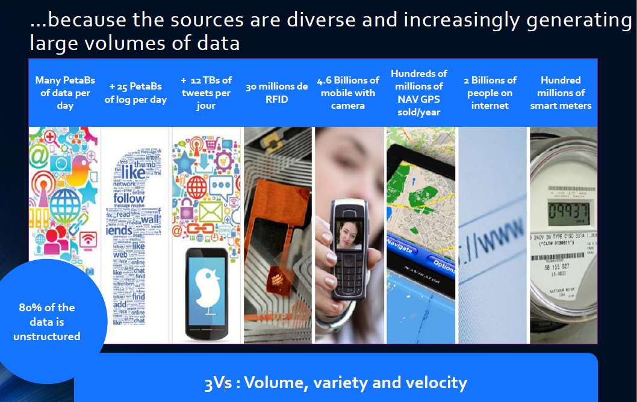
42 Abu Dhabi
Big Data Analytics:

Slide 37
42 Abu Dhabi
Technology Adoption Challenges:
A majority of organizations cite people, process or technology challenges to digital transformation.
People challenges are most commonly cited by customers - difficulties achieving the culture change or buy-in required to drive a transformation, breaking down the organizational siloes between functional, or unleashing the skills of digital innovators.
Process: As business processes and transactions cross multiple environments, organizations must:
Be aware of the new risks involved, and ensure security, visibility and control at each touch point.
And ensure processes are adaptable to cross beyond the boundaries of the traditional organizational ecosystem.
Technology: How do you maximize flexibility? To use not only your own data, apps and services, but also those from anywhere you want, and be confident you’ll have that flexibility into the future?
You need a flexible, open IT foundation that can handle data from any source, with rapid scalability, on demand.

Slide 38
42 Abu Dhabi
Technology Adoption Challenges:
PEOPLE
Organizational siloes and skill gaps
Require collaboration across Line of Business (LoB), IT and ecosystems like never before
PROCESS
Business processes and transactions span multiple environments
Demands security, visibility and control at each touch point to mitigate new risks
TECHNOLOGY
Fast, secure, controlled access to data
Identifying, integrating, and analyzing the right data across diverse ecosystems
Flexibility for the future
To use any data, applications, services and devices

Slide 39
42 Abu Dhabi
Additional Resources:
Goodbye Blockbuster: 3 Reasons You Need a Strong Digital Strategy, https://quuu.co/blog/3-reasons-digital-strategy/
Digital Transformation in Retail: How Starbucks, IKEA, Walmart, and Sephora Revolutionize Industry, https://www.altexsoft.com/blog/business/digital-transformation-stories-how-starbucks-ikea-walmart-and-sephora-revolutionize-retail-industry/
4 High-Profile Digital Transformation Failures (+Causes), https://whatfix.com/blog/digital-transformation-failures/
Coca-Cola: The people-first story of a digital transformation : https://www.mckinsey.com/capabilities/operations/our-insights/coca-cola-the-people-first-story-of-a-digital-transformation
Companies That Failed At Digital Transformation And What We Can Learn From Them
https://www.linkedin.com/pulse/companies-failed-digital-transformation-what-we-can-learn-morgan-1c?trk=articles_directory

Slide 40
42 Abu Dhabi
Digital Transformation - Team up:
You and your team choose the company and discuss for the teamwork of driving digital transformation.
First, introduce the company and describe the current challenges and opportunities the company is facing due to digital transformation.
Then recommend changes the company needs to make to address these challenges or take advantages of these opportunities.
You need to consider any organizational changes the company needs to make, and potential internal resistance when implementing your recommendation (and strategies to overcome such resistance).
You and your team can come up and give a presentation to the class.

Slide 41
42 Abu Dhabi
Digital Transformation - Team up:
Walmart Supply Chain Management : https://business-essay.com/wal-marts-supply-chain-management-and-technology/
Describe Wal-Mart’s supply chain and how it integrates with other elements of its strategy.
Identify the characteristics of the Walmart supply chain that makes it so successful and describe how they are improving the Walmart’s supply chain.
Discuss the role of IT in Walmart supply chain.

Slide 42
42 Abu Dhabi
Class Activity:
8 Examples of Innovative Digital Transformation Case Studies (2022) : https://whatfix.com/blog/digital-transformation-examples/

